Slide 1
Week 02 – OAL Activity
Go to Linkedin Learning course - Express Essentials: Build Powerful Web Apps with Node.js by Jamie Pittman (https://www.linkedin.com/learning/express-essentials-build-powerful-web-apps-with-node-js)
Complete the following (as indicated in the next slide):
Express Routing Fundamentals
Express Essentials: Middleware
Taking Express One Step Further
Conclusion
Quiz will be conducted in class to test for understanding.

Slide 2
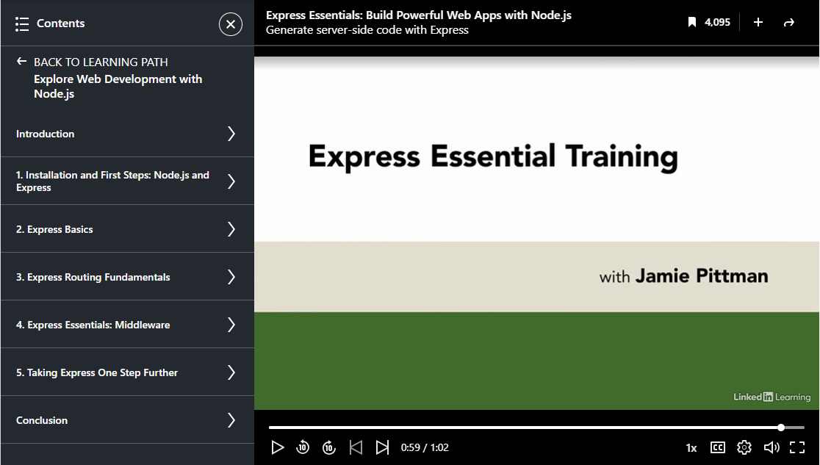
Week 02 – OAL Activity

